Slide 1
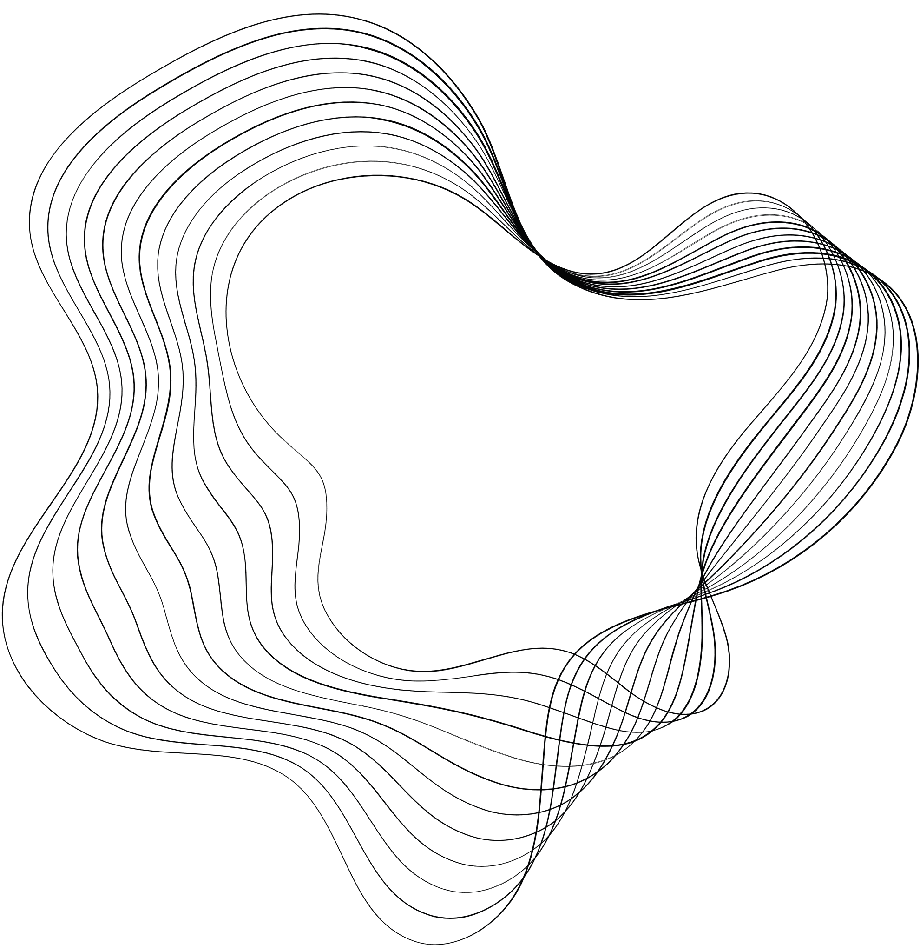

TOURISM
PROJECT
we are happy to introduce our project to you
and we hope that it nail your satisfaction

Slide 2
MEMBERS
01
Mustafa Maghraby 1700352
02
Andrew amier 2000385
03
Saber ahmed 2001314
Supervied By
Dr. Rodaina Abdelsalam
Eng. Amany Emad
04
Mohamed mahmoud 2001871
05
Mohamed mahmoud 2001510
06
Mahmoud khaled 2001682
07
Mina hilal 1900247
08
MARCO ABDO 2001649

Slide 3

ABSTRACT
This project aims to enhance tourism in Egypt through an integrated digital platform featuring a web and mobile application, powered by an AI-driven chatbot and a sophisticated recommendation system
The platform is designed to offer personalized travel guidance and suggestions, improving the overall tourist experience with a focus on user-friendly navigation and engaging UI/UX design.
By leveraging machine learning algorithms for tailored recommendations and employing natural language processing for real-time assistance,
the project seeks to modernize tourism in Egypt, making it more accessible, convenient, and customized for visitors. This initiative not only aims to transform the visitor experience but also to support the growth of Egypt's tourism sector by promoting cultural and historical attractions through advanced technology.

Slide 4
OUTLINE
CURRENT PROGRESS
INTRODUCTION
RESEARCH OBJECTIVE
CONCLUTION
PROBLEM SATAMENT
TIME PLAN
RELEATED WORK
METHDOLOGY OF PROPOSED APPROACH

Slide 5
INTRODUCTION
This project introduces a new way to explore Egypt by integrating a digital platform with web and mobile applications, an AI-powered Chabot, and a custom recommendation engine. It features an intuitive UI/UX design that simplifies the travel planning process and enhances the discovery of Egypt’s cultural and historical treasures. The platform aims to be user-friendly, offering immediate personalized support via a Chabot utilizing advanced natural language processing and tailored travel suggestions through its recommendation system. This initiative not only seeks to make travel planning more intuitive and enjoyable but also aims to elevate Egypt’s tourism industry and draw international attention to its attractions through cutting-edge technology and thoughtful design.

Slide 6
PROBLEM STATMENT
The tourism sector in Egypt faces the challenge of effectively engaging a diverse and ever-growing international visitor base, ensuring they have access to up-to-date information and personalized travel experiences. While Egypt offers a wealth of health, cultural, and entertainment options, potential tourists may find it overwhelming to sift through the abundance of choices and logistical details necessary to plan their visit.

Slide 7
PROBLEM STATMENT
There is a need for a solution that can streamline the process of selecting activities, understanding service costs, and customizing travel itineraries to fit individual preferences and schedules. This solution must be capable of handling the complexities of Egypt's varied tourism landscape and must deliver this service in a user-friendly, accessible manner to enhance the overall experience of visiting Egypt.

Slide 8


RELATED WORK
01
02
03
04
Yellow.ai
FlowXO
Verloop
chatfuel

Slide 9
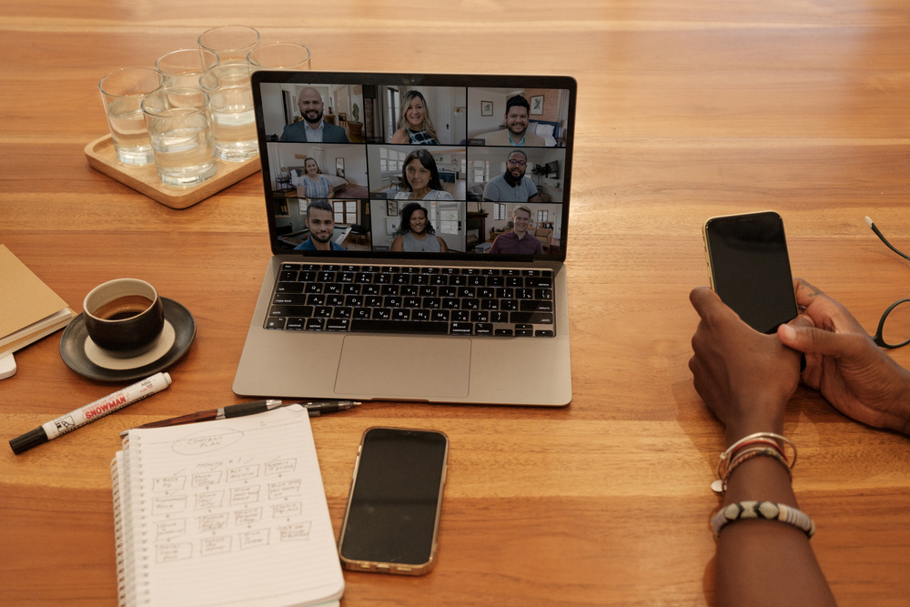
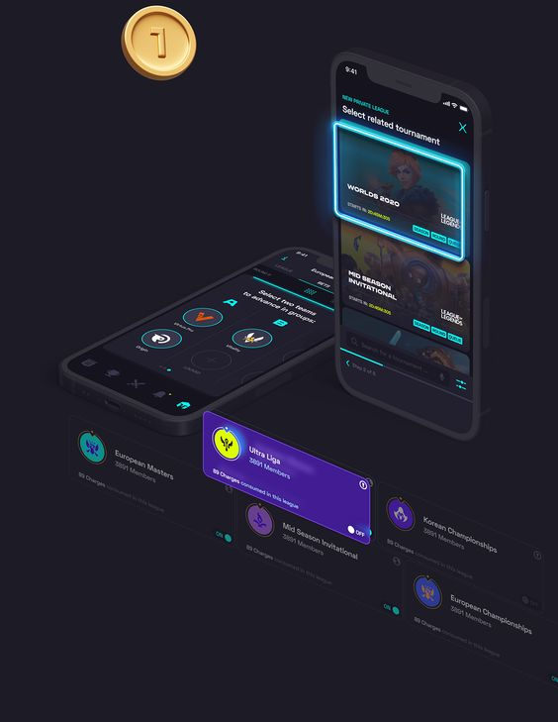
FIRST YELLOW.AI
YELLOW.AI
The chatbots can be more learning-based for non-e-commerce businesses.
Some components require deep knowledge on the technical side making it difficult for users of non-technical backgrounds.
OUR PROJECT
IT’S EASY TO USE FOR USER DOSEN’T NEED ANY technical backgrounds.
ALL THE TASKS CAN BE MANGED BY CHAT-BOT OR THE USER HIMSELF CAN PREFORM HIS
TASKS ON WEBSITE OR THE APPLICATION

Slide 10
SECOND FLOWXO
FLOWXO
Being too friendly shows a level of unprofessionalism
OUR PROJECT
USER GET ONLY WHAT HE WANT WITH PROFESSIONAL OUTPUT

Slide 11
THIRD VERLOOP
VERLOOP
It has a lot of direction and tutorials which makes it difficult for the user to understand and use it.
The costs are too high as per the others in the market.
OUR PROJECT
IT HAS WELL DEFIEND EASY STEPS THAT DON’T BOTHER THE USER
IT’S TOTALY FREE

Slide 12
FOURTH Chatfuel
Chatfuel
Documentation is poor. There is no support for subroutines, or jumping around a conversation.
OUR PROJECT
IT HAS SUPPORT AND PROVIDED WITH THE BEST TEQNUINCS IN AI SIDE

Slide 13
METHDOLOGY
METHODOLOGY
NLTK LIBRARY
RANDOM FOREST
REGRESSION
UI - UX
WEB DEV
AI
APPLICATION
FIGMA PLATFORM
FRONT END :
HTML -CSS- JS -TAILWINDCSS
FLUTTER

Slide 14

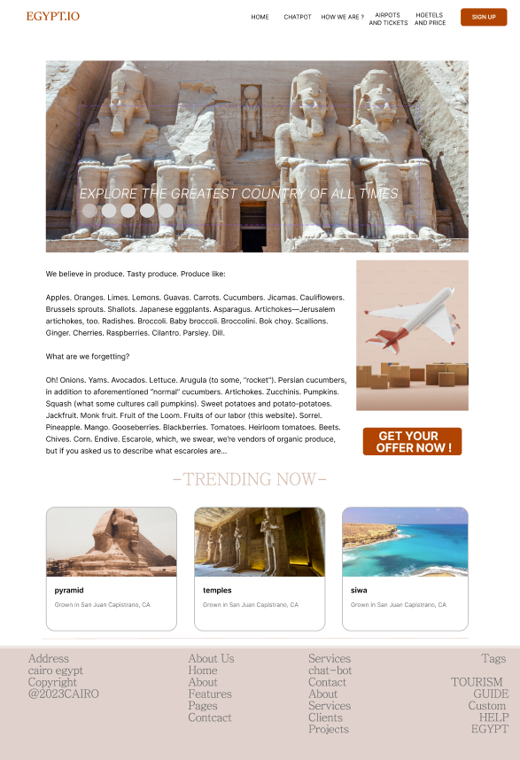
UI-UX
NAV BAR ALOCATE DEFFRENT PAGES TO MAKE IT EASY FOR THE USER TO FIND WHAT HE WANT
FIRST PAGE HOME PAGE THAT SHOWES THE USER A BREIF ABOUT EGYPT AND TRENDING PLACES NOW

Slide 15
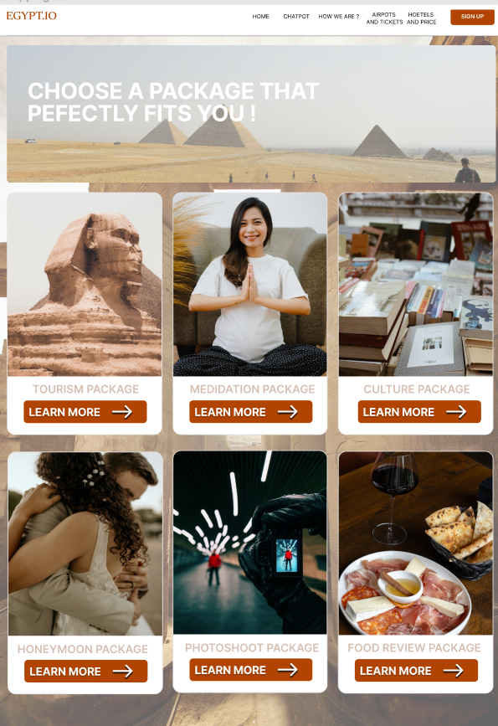
UI-UX
SECOND PAGE PACKAGE PAGE THAT SHOWES THE USER MANY PACKAGES AND HE CHOOSE WHAT SUIT HIM IN THOSE

Slide 16
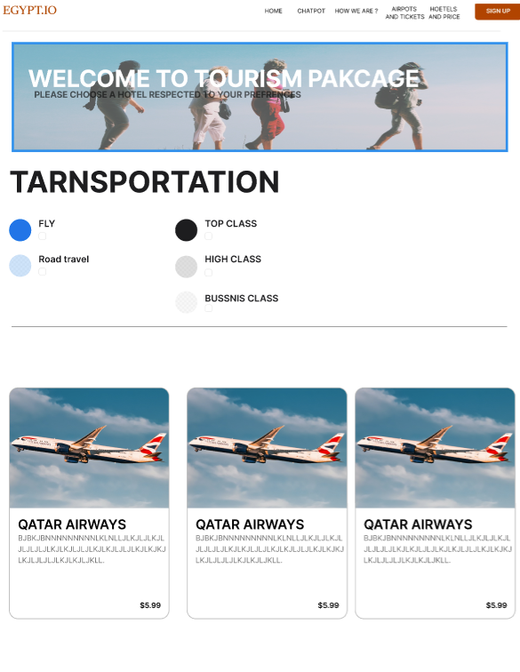
UI-UX
THIRD PAGE IF HE CHOOSE TOURISM PACKAGE IN PACKAGE PAGE WELL APPEAR TRANSPOARTATION PAGE FOR TOURISM PACKAGE THAT SHOWES THE USER MANY TRANSPOARTATION WAYS AND HE CHOOSE WHAT SUIT HIM IN THOSE

Slide 17
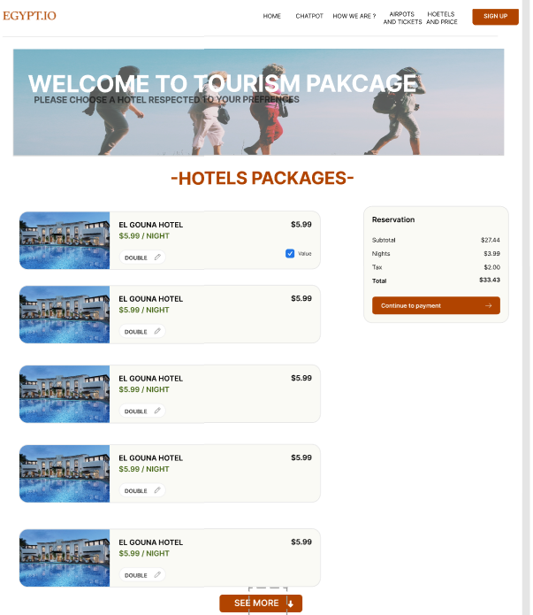
UI-UX
THIRD PAGE IF HE CHOOSE TOURISM PACKAGE IN PACKAGE PAGE WELL APPEAR AFTER TRANSPOARTATION PAGE A HOTELS PAGE FOR TOURISM PACKAGE THAT SHOWES THE USER MANY HOTELS AND HE CHOOSE WHAT SUIT HIM IN THOSE

Slide 18
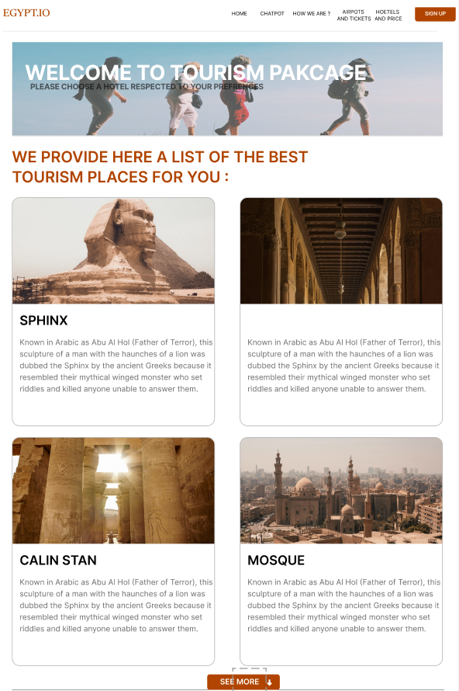
UI-UX
THIRD PAGE IF HE CHOOSE TOURISM PACKAGE IN PACKAGE PAGE WELL APPEAR AFTER TRANSPOARTATION PAGE AND HOTELS PAGE FOR TOURISM PACKAGE THAT SHOWES THE USER MANY TOURISM SITES AND PLACES AND HE CHOOSE WHAT HE WANT TO VISIT

Slide 19
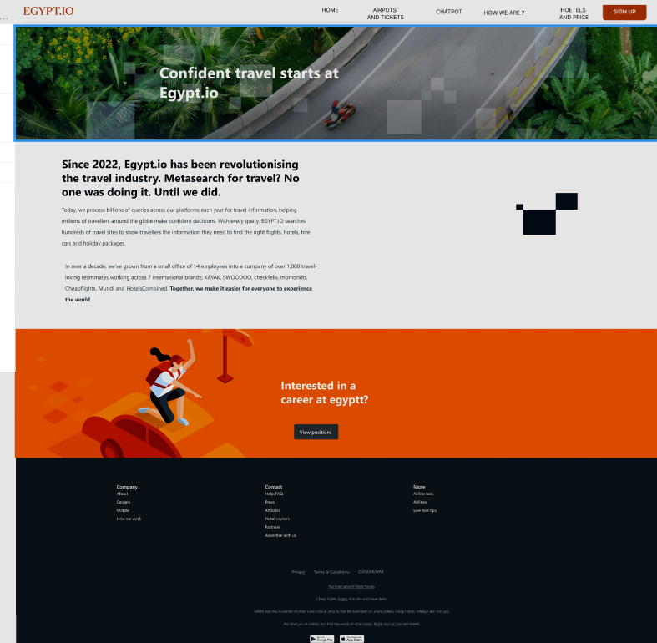
UI-UX
ABOUT US PAGE THAT HAVE A BERIF ABOUT OUR COMPANY

Slide 20
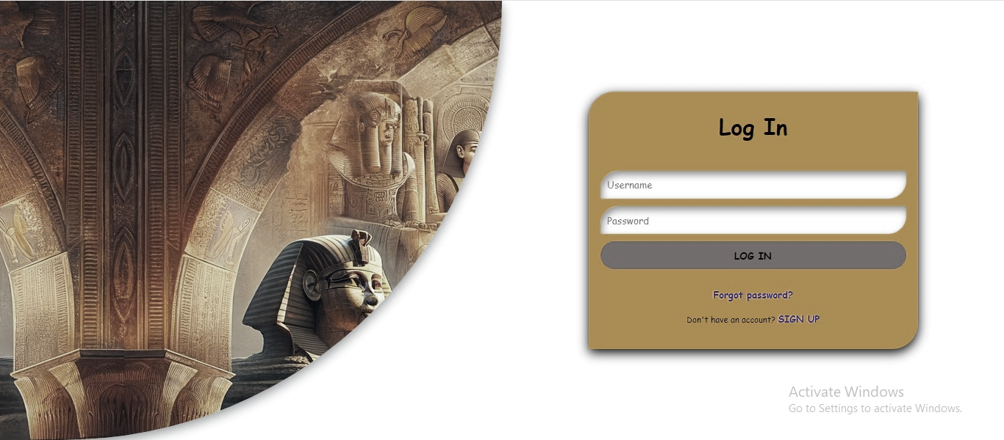
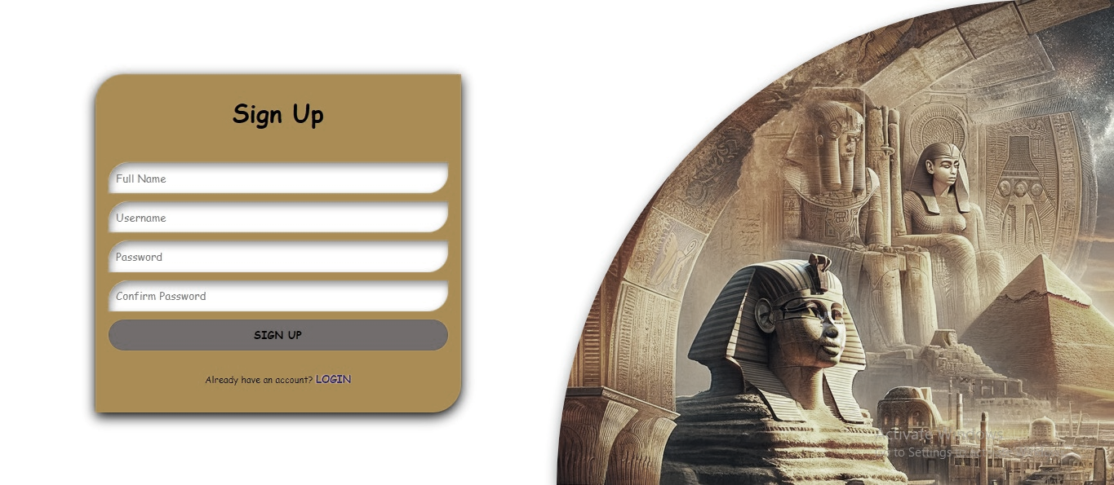
UI-UX
LOGIN FORM IF HE ALREADY HAVE AN ACCOUNT
SIGN UP FORM IF IT IS THE FIRST TIME FOR HIM

Slide 21
we are going to build a chatbot using deep learning and flask techniques.
The chatbot will be trained on the dataset which contains categories (intents), pattern and responses.
We use a special artificial neural network (ANN) to classify which category the user’s message belongs to and then we will give a random response from the list of responses.
Project File Structure:
data.json: this file will contain all our data (intents, questions, responses).
training.py: this file we wrote a script to build the model and train our chatbot.
app.py: this is flask Python script in which we implemented web-based GUI for our chatbot (Launch the chatbot).
Front-end

Slide 22
Front-end
Why using the web methodology ?
- to make a better interaction between the user and the chatbot
- Using a website for tourism provides a convenient platform to access information about destinations, accommodations, activities, and travel tips. It allows users to plan trips, compare options, and make bookings online, enhancing the overall travel experience. Websites also serve as valuable resources for reviews, local insights, and real-time updates, helping travelers make informed decisions.

Slide 23
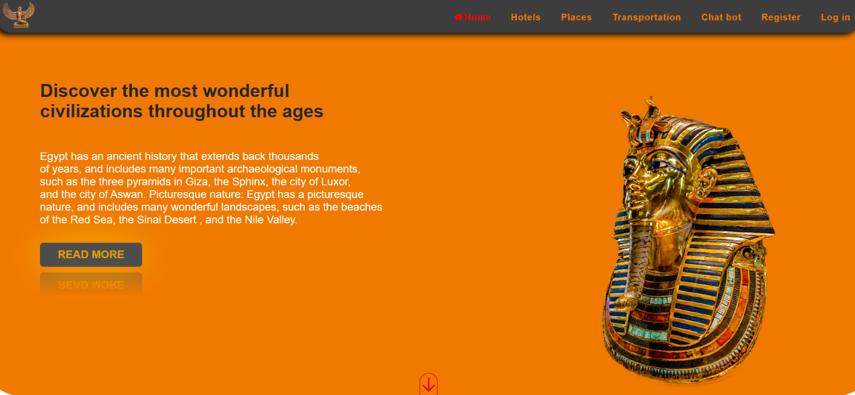
Front-end
Home page

Slide 24
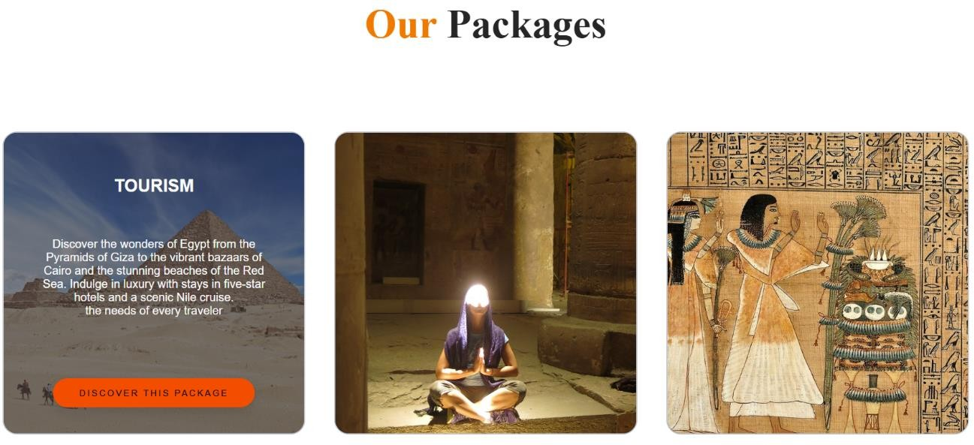
Front end
Our packages

Slide 25
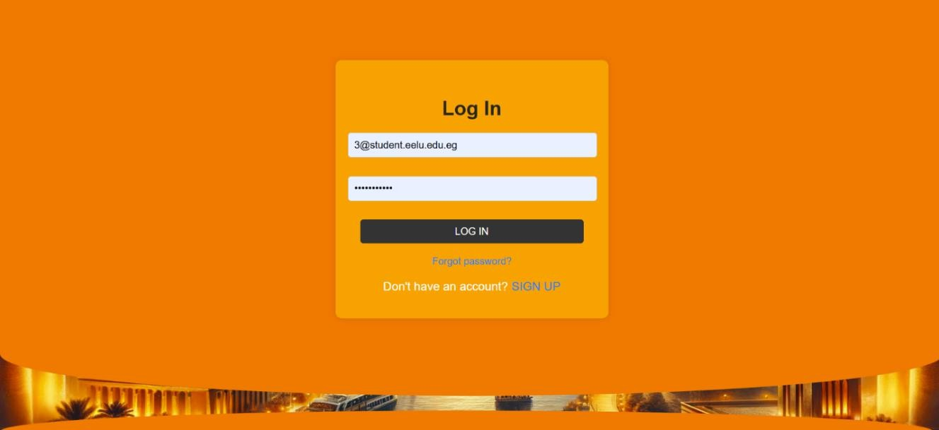
Front end
Login

Slide 26
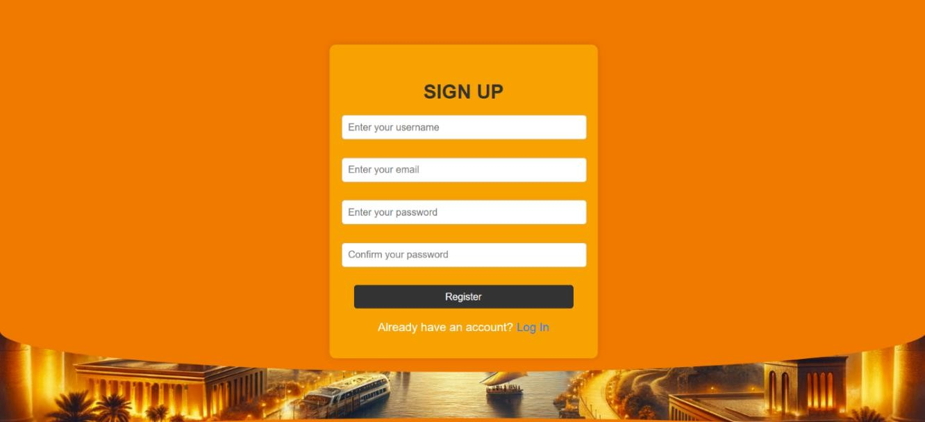
Front end
Sign up

Slide 27
we are going to build a chatbot using deep learning and flask techniques.
The chatbot will be trained on the dataset which contains categories (intents), pattern and responses.
We use a special artificial neural network (ANN) to classify which category the user’s message belongs to and then we will give a random response from the list of responses.
Project File Structure:
data.json: this file will contain all our data (intents, questions, responses).
training.py: this file we wrote a script to build the model and train our chatbot.
app.py: this is flask Python script in which we implemented web-based GUI for our chatbot (Launch the chatbot).
CHAT-BOT

Slide 28
we are going to build a chatbot using deep learning and flask techniques.
The chatbot will be trained on the dataset which contains categories (intents), pattern and responses.
We use a special artificial neural network (ANN) to classify which category the user’s message belongs to and then we will give a random response from the list of responses.
Project File Structure:
data.json: this file will contain all our data (intents, questions, responses).
training.py: this file we wrote a script to build the model and train our chatbot.
app.py: this is flask Python script in which we implemented web-based GUI for our chatbot (Launch the chatbot).
CHAT-BOT
Topics:
Tourist Guide Chatbot Overview.
Tools and Technologies that are used to build the Chat-bot.
Chat-bot project structure and how it work.
Screenshots

Slide 29
we are going to build a chatbot using deep learning and flask techniques.
The chatbot will be trained on the dataset which contains categories (intents), pattern and responses.
We use a special artificial neural network (ANN) to classify which category the user’s message belongs to and then we will give a random response from the list of responses.
Project File Structure:
data.json: this file will contain all our data (intents, questions, responses).
training.py: this file we wrote a script to build the model and train our chatbot.
app.py: this is flask Python script in which we implemented web-based GUI for our chatbot (Launch the chatbot).
CHAT-BOT
Tourist Guide Chatbot Overview
Use Artificial Intelligence, particularly Natural Language Processing (NLP) and Deep learning.
Chatbots can operate round the clock, providing support and information at any time.
Users prefer to use chatbots, because it simple to use and provide a lot of information faster than using Google or any other Search Engines.
Tourist Guide Chatbot is a limited scope chatbot that is used in Tourism industry only.
Our chatbot can recommend hotels and Tourist places to visit in (Cairo, Alexandria, Giza, Luxor, Aswan, Hurghada, Sharm)

Slide 30
CHAT-BOT
In our chat-bot we use some tools and technologies, that we need to talk about why we use them, and these tools are:
Python Programming Language.
Tensorflow and Keras.
NLTK (Natural Language Toolkit).
Html / Css
Flask
JSON

Slide 31
we are going to build a chatbot using deep learning and flask techniques.
The chatbot will be trained on the dataset which contains categories (intents), pattern and responses.
We use a special artificial neural network (ANN) to classify which category the user’s message belongs to and then we will give a random response from the list of responses.
Project File Structure:
data.json: this file will contain all our data (intents, questions, responses).
training.py: this file we wrote a script to build the model and train our chatbot.
app.py: this is flask Python script in which we implemented web-based GUI for our chatbot (Launch the chatbot).
CHAT-BOT
Why Python .. ??
Python is a popular programming language for build an Ai model, because it offers a wide range of libraries and frameworks, such as NLTK, Flask and TensorFlow, which simplify the development of natural language processing and deep learning models.
Python is simple and readable syntax.
Python has a large and active community that providing a help.

Slide 32
we are going to build a chatbot using deep learning and flask techniques.
The chatbot will be trained on the dataset which contains categories (intents), pattern and responses.
We use a special artificial neural network (ANN) to classify which category the user’s message belongs to and then we will give a random response from the list of responses.
Project File Structure:
data.json: this file will contain all our data (intents, questions, responses).
training.py: this file we wrote a script to build the model and train our chatbot.
app.py: this is flask Python script in which we implemented web-based GUI for our chatbot (Launch the chatbot).
CHAT-BOT
Why Tensorflow and Keras libraries'??
Python is a popular programming language for build an Ai model, because it offers a wide range of libraries and frameworks, such as NLTK, Flask and TensorFlow, which simplify the development of natural language processing and deep learning models.
Python is simple and readable syntax.
Python has a large and active community that providing a help.

Slide 33
we are going to build a chatbot using deep learning and flask techniques.
The chatbot will be trained on the dataset which contains categories (intents), pattern and responses.
We use a special artificial neural network (ANN) to classify which category the user’s message belongs to and then we will give a random response from the list of responses.
Project File Structure:
data.json: this file will contain all our data (intents, questions, responses).
training.py: this file we wrote a script to build the model and train our chatbot.
app.py: this is flask Python script in which we implemented web-based GUI for our chatbot (Launch the chatbot).
CHAT-BOT
Why NLTK ?
NLTK provides tools and resources for various NLP tasks, including tokenization and lemmatization which we will need these tools to process and analysis user input text.
Tokenization: is a process for breaking down text into smaller pieces called tokens. tokens can be word or phrase or even character.
Lemmatization: is a process for reducing the word to its root form, known as lemma.
So, in summary NLTK Library is a library that provide a lot of tools in Text processing and Text analysis, which we will use to analysis the user input text and prepare input text for the model to understand.

Slide 34
we are going to build a chatbot using deep learning and flask techniques.
The chatbot will be trained on the dataset which contains categories (intents), pattern and responses.
We use a special artificial neural network (ANN) to classify which category the user’s message belongs to and then we will give a random response from the list of responses.
Project File Structure:
data.json: this file will contain all our data (intents, questions, responses).
training.py: this file we wrote a script to build the model and train our chatbot.
app.py: this is flask Python script in which we implemented web-based GUI for our chatbot (Launch the chatbot).
CHAT-BOT
Why “Html – Css” ?
Out Chat-bot is a Web-based, which mean that is run on the browser.
So, We need Html and Css to build and design the template of the chat-bot.

Slide 35
we are going to build a chatbot using deep learning and flask techniques.
The chatbot will be trained on the dataset which contains categories (intents), pattern and responses.
We use a special artificial neural network (ANN) to classify which category the user’s message belongs to and then we will give a random response from the list of responses.
Project File Structure:
data.json: this file will contain all our data (intents, questions, responses).
training.py: this file we wrote a script to build the model and train our chatbot.
app.py: this is flask Python script in which we implemented web-based GUI for our chatbot (Launch the chatbot).
CHAT-BOT
Why Flask ?
As i we mentioned before, our chatbot is a web-based and we built the template by using Html and Css.
Now we need a way to connect between Chatbot Template and Python Model.
And we choice Python Flask micro framework to perform this job.
Flask is a micro web framework that provides the essential tools to get a web application up and running quickly.
Flask is simple.

Slide 36
we are going to build a chatbot using deep learning and flask techniques.
The chatbot will be trained on the dataset which contains categories (intents), pattern and responses.
We use a special artificial neural network (ANN) to classify which category the user’s message belongs to and then we will give a random response from the list of responses.
Project File Structure:
data.json: this file will contain all our data (intents, questions, responses).
training.py: this file we wrote a script to build the model and train our chatbot.
app.py: this is flask Python script in which we implemented web-based GUI for our chatbot (Launch the chatbot).
CHAT-BOT
Why JSON ??
Python is a popular programming language for build an Ai model, because it offers a wide range of libraries and frameworks, such as NLTK, Flask and TensorFlow, which simplify the development of natural language processing and deep learning models.
Python is simple and readable syntax.
Python has a large and active community that providing a help.

Slide 37
we are going to build a chatbot using deep learning and flask techniques.
The chatbot will be trained on the dataset which contains categories (intents), pattern and responses.
We use a special artificial neural network (ANN) to classify which category the user’s message belongs to and then we will give a random response from the list of responses.
Project File Structure:
data.json: this file will contain all our data (intents, questions, responses).
training.py: this file we wrote a script to build the model and train our chatbot.
app.py: this is flask Python script in which we implemented web-based GUI for our chatbot (Launch the chatbot).
CHAT-BOT
Chatbot Project Structure & How it work
Our Project File Structure is:
data.json
training.py
app.py

Slide 38
data.json
CHAT-BOT
This file contain all our dataset that we will use in our model.
This file consist of many groups (“Intents”) and each group contain many questions and respon
Hotels of (Cairo, Alexandria, Giza, Aswan, Luxor, Sharm, Hurghada)
Tourist Places of (Cairo, Alexandria, Giza, Aswan, Luxor, Sharm, Hurghada)
General

Slide 39
we are going to build a chatbot using deep learning and flask techniques.
The chatbot will be trained on the dataset which contains categories (intents), pattern and responses.
We use a special artificial neural network (ANN) to classify which category the user’s message belongs to and then we will give a random response from the list of responses.
Project File Structure:
data.json: this file will contain all our data (intents, questions, responses).
training.py: this file we wrote a script to build the model and train our chatbot.
app.py: this is flask Python script in which we implemented web-based GUI for our chatbot (Launch the chatbot).
CHAT-BOT
training.py
In this file we load our data.json file
Our data is already clean because we collect them by our self.
So we build the Artificial Neural Network Model by using Tensor flow and Keras.
We fit the model (“Make model train on the data”).
Then we extract the model in external file called model.h5
h5 mean that our model is trained on Hierarchical data format (Multidimensional array data).

Slide 40
we are going to build a chatbot using deep learning and flask techniques.
The chatbot will be trained on the dataset which contains categories (intents), pattern and responses.
We use a special artificial neural network (ANN) to classify which category the user’s message belongs to and then we will give a random response from the list of responses.
Project File Structure:
data.json: this file will contain all our data (intents, questions, responses).
training.py: this file we wrote a script to build the model and train our chatbot.
app.py: this is flask Python script in which we implemented web-based GUI for our chatbot (Launch the chatbot).
CHAT-BOT
app.py
In this file we load the model.h5
we build our flask web page by using the template that we built before by using Html / Css
And we run the Flask page from it.

Slide 41
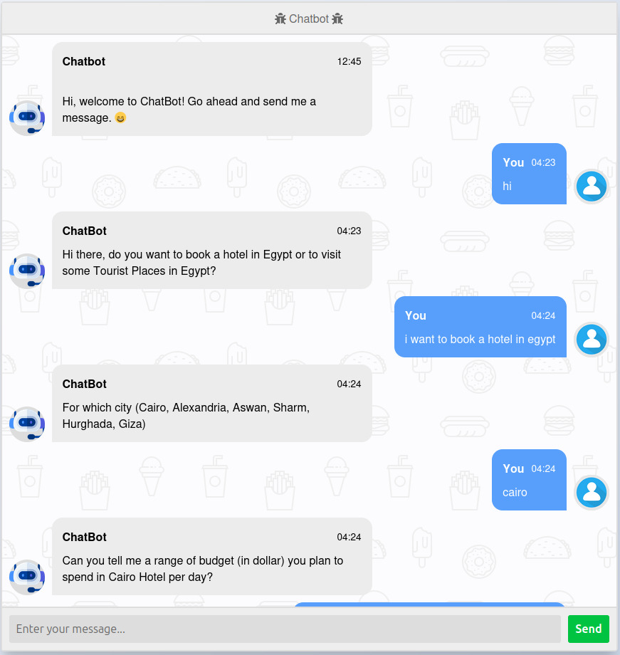
CHAT-BOT
Screenshots for
chat-bot

Slide 42
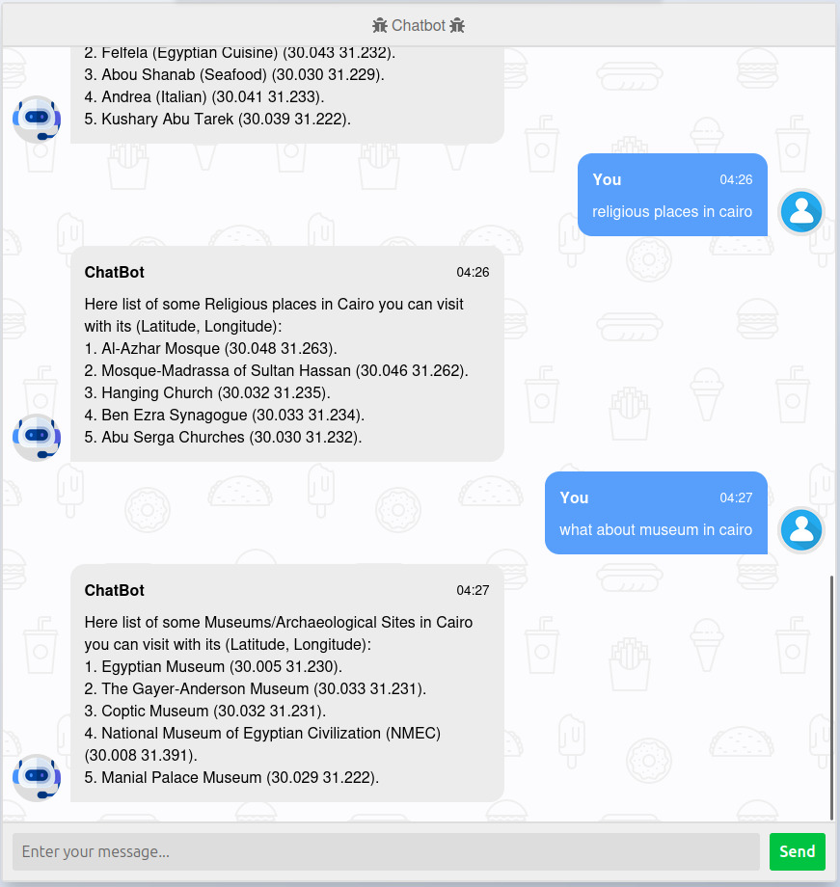
CHAT-BOT
Screenshots for
chat-bot

Slide 43
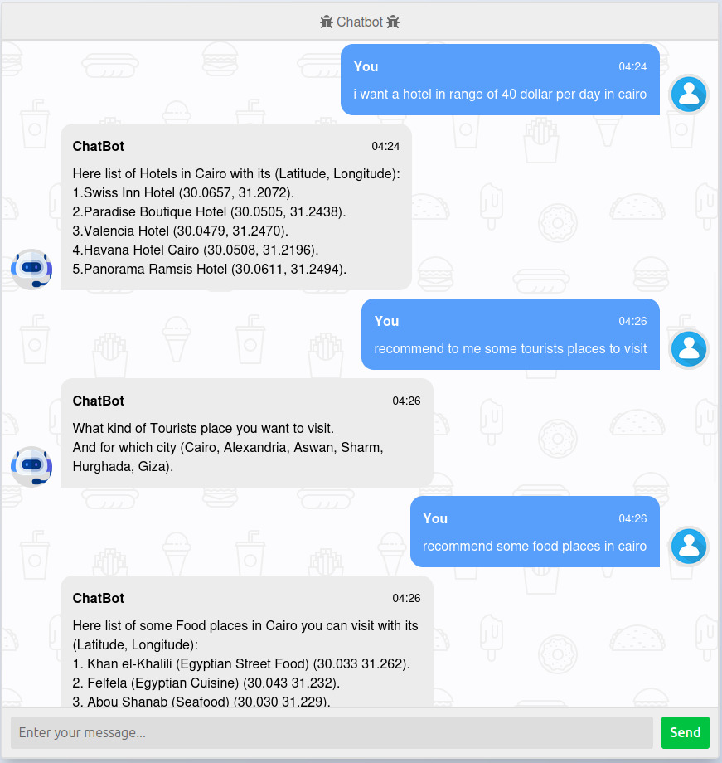
CHAT-BOT
Screenshots for
chat-bot

Slide 44
we are going to build a chatbot using deep learning and flask techniques.
The chatbot will be trained on the dataset which contains categories (intents), pattern and responses.
We use a special artificial neural network (ANN) to classify which category the user’s message belongs to and then we will give a random response from the list of responses.
Project File Structure:
data.json: this file will contain all our data (intents, questions, responses).
training.py: this file we wrote a script to build the model and train our chatbot.
app.py: this is flask Python script in which we implemented web-based GUI for our chatbot (Launch the chatbot).
Application
EGYPT.IO

Slide 45

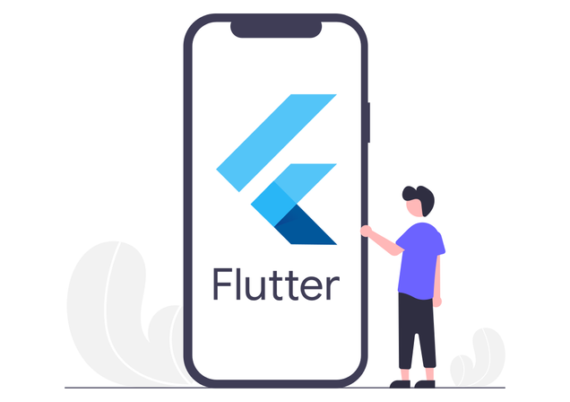
Our Sub Team & Technologies
UI & Design
Flutter

Slide 46
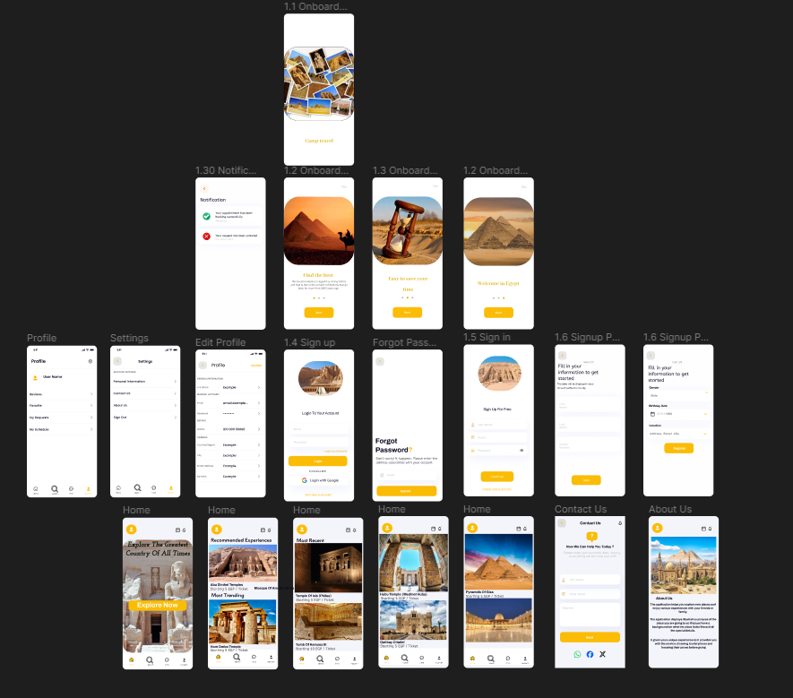
progress in interface & data base design.
Using the Figma program, the team was able to complete the design.
The team was also able to complete the data base design.
User Interface
50%

Slide 47
FLUTTER PROGRESS
Functions has Already Developed
Login Authentication Function
And store the initial data we need
from users like Email, Password ,type
and age

Slide 48
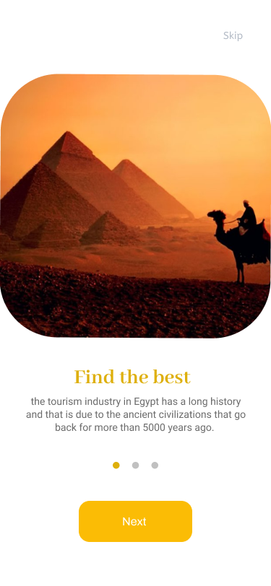
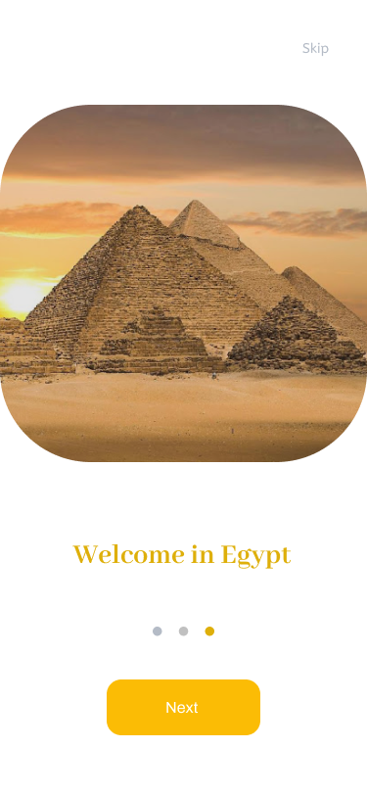
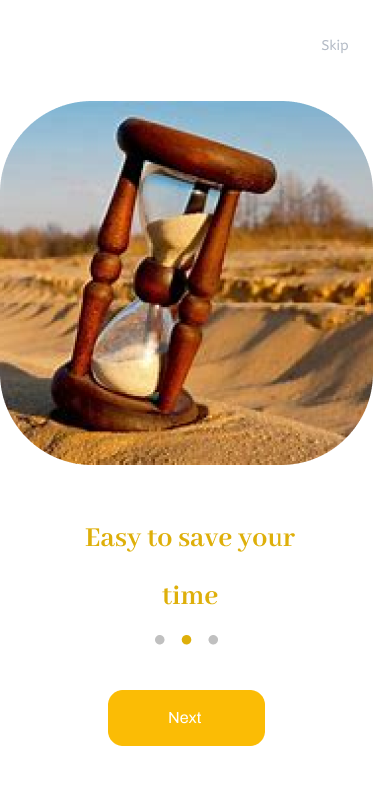
Splash screen:
Inaugural pages are three pages In these opening pages we present small details about the program we offer.

Slide 49
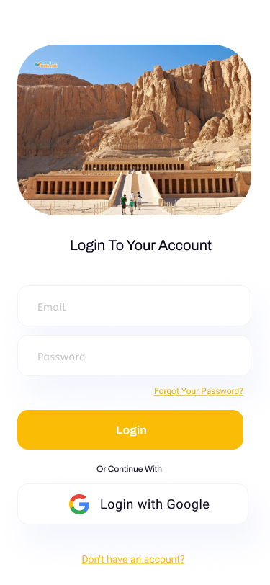
Login Authentication Function Description
Getting From the users email and password.
Check if it is valid or not and catch any type of errors and handling it.
Firebase Authentication.
Based on that response the user interface changes.
Google Authentication.

Slide 50
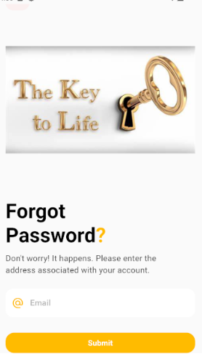
Forgetting Password Function Description
If the user is unable to log in because he forgot the password, his attacker can set it through this page by typing in his Gmail.

Slide 51
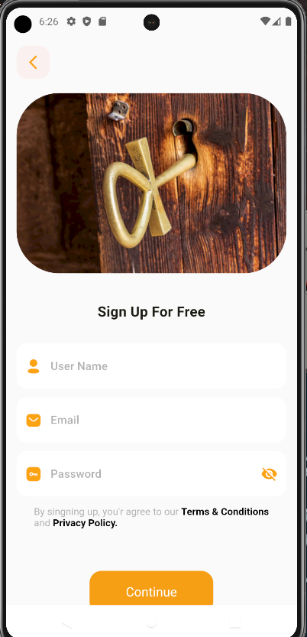
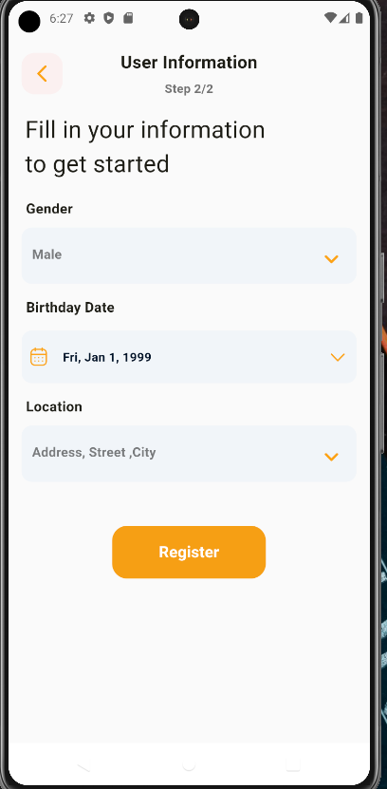
sign up Function Description
We ask from the user basic required data.
Like Username, phone number , gender and Birth date.
Then send this information to fire store Before that chick, its valid data or not

Slide 52
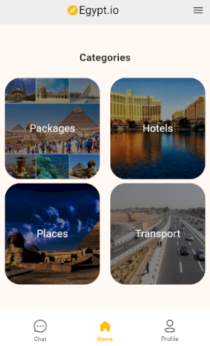
Home Screen Page:
Through this page, we display all the services that we provide, such as:
-packages.
- Hotels.
-tourist places, and transportation.
At the bottom is the bar for navigating between the home page, the chatbot page, and the profile page

Slide 53
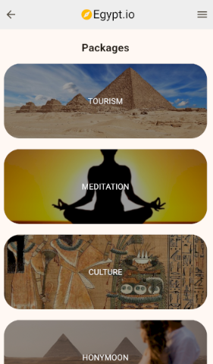
Packages Page :
On this page, we display a group of packages, and each package has a specific section, each section contains 10 hotels and 10 tourist places.
we will display this on the next page.

Slide 54
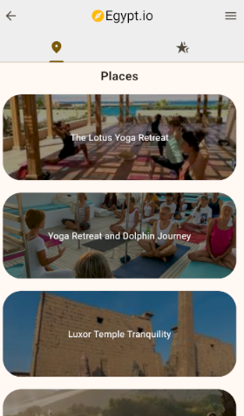
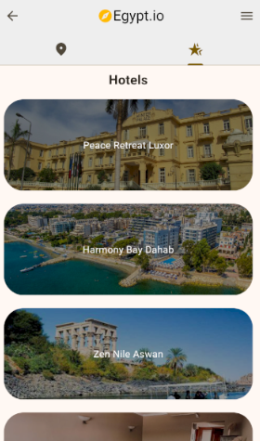
Packages Details Page :

Slide 55
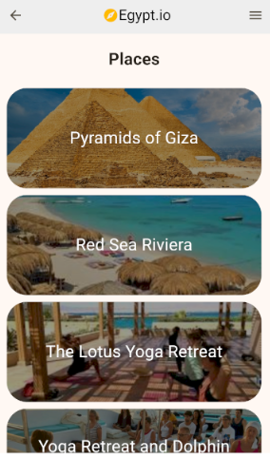
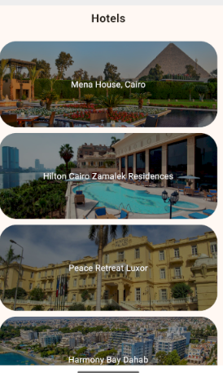
Hotels and Places Page:
On these pages we display the most highly rated hotels and places.
Each section contains 60 hotels and 60 tourist places.
When selecting one of the cards, we can see more details.

Slide 56
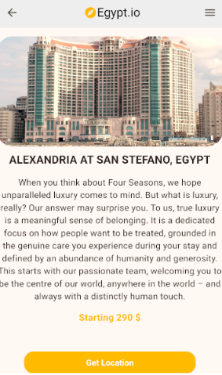
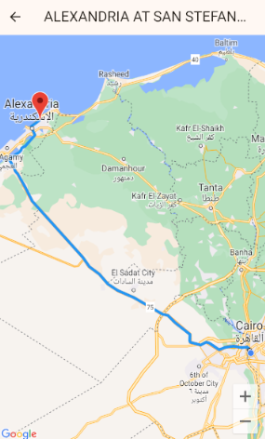
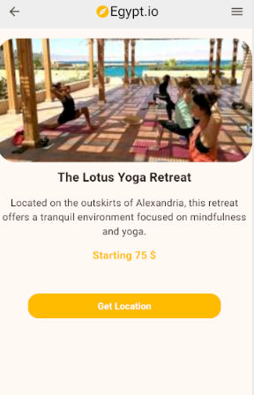
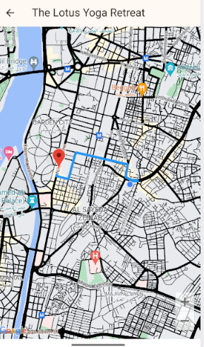
Details about places and hotels

Slide 57
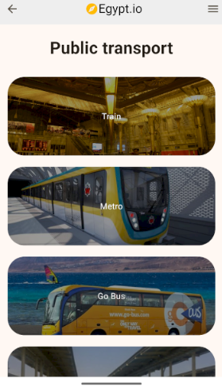
Show the most commonly used and easiest means of transportation

Slide 58
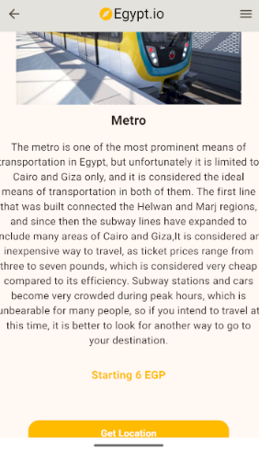
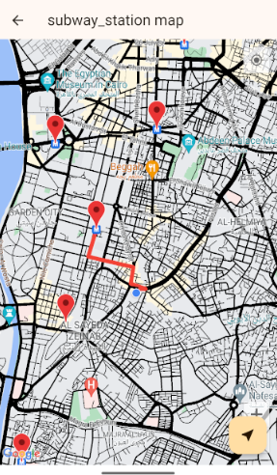
Transportation:
On these pages, choose your metro card:
Through it we can know some details about it and know the ticket prices.
Find the nearest station relative to the user's location.

Slide 59
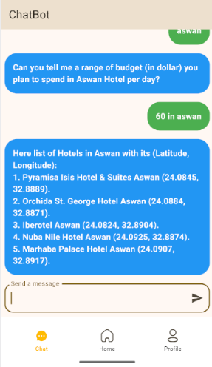
Chatting:
On this page, I made a link between the program and Ai so that the user can ask questions if he needs guidance.

Slide 60
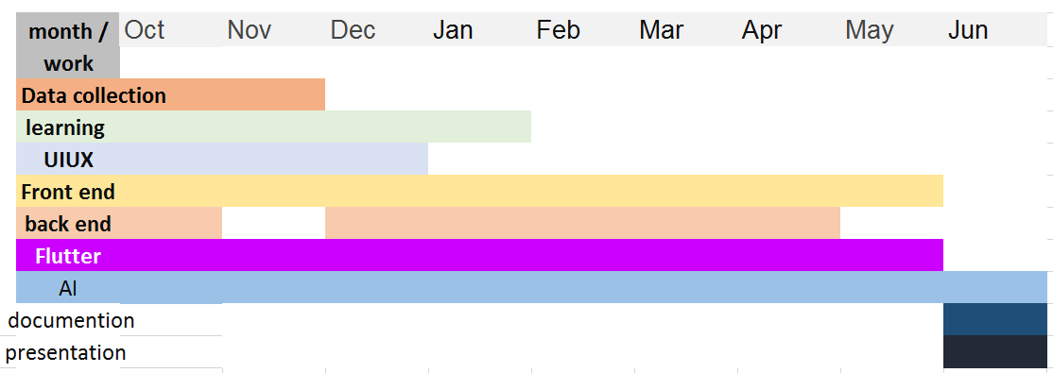
PROJECT TIMELINE

Slide 61
CONCLUSION
In summary, the combination of a Tourism Guide Chat-Bot and a dedicated Tourism website in Egypt offers a comprehensive solution to cater to the needs of travelers. While the Chat-Bot provides instant, personalized assistance and recommendations, the website serves as a centralized platform for detailed information, bookings, and itinerary planning. Together, they enhance accessibility, convenience, and satisfaction for tourists, contributing to the growth and promotion of Egypt's tourism industry. This integration leverages technology to provide seamless and efficient support, ensuring a memorable experience for visitors exploring the wonders of Egypt.

Slide 62

THANK'S FOR WATCHING
HOPE YOU ENJOY IT .

